Slide 1
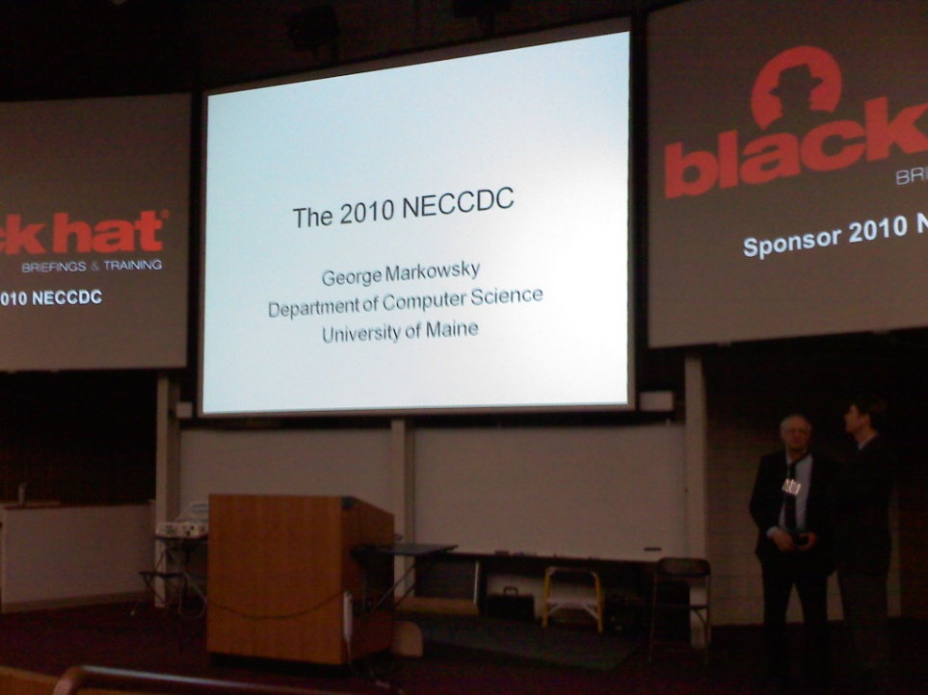
Collegiate Cyber Defense Competition
Ben Actis
Notes:
Introduce myself
Last year at Champlain college
Bachelors degree in cnis
Pres of cnis club
Also captain of team this year

Slide 2
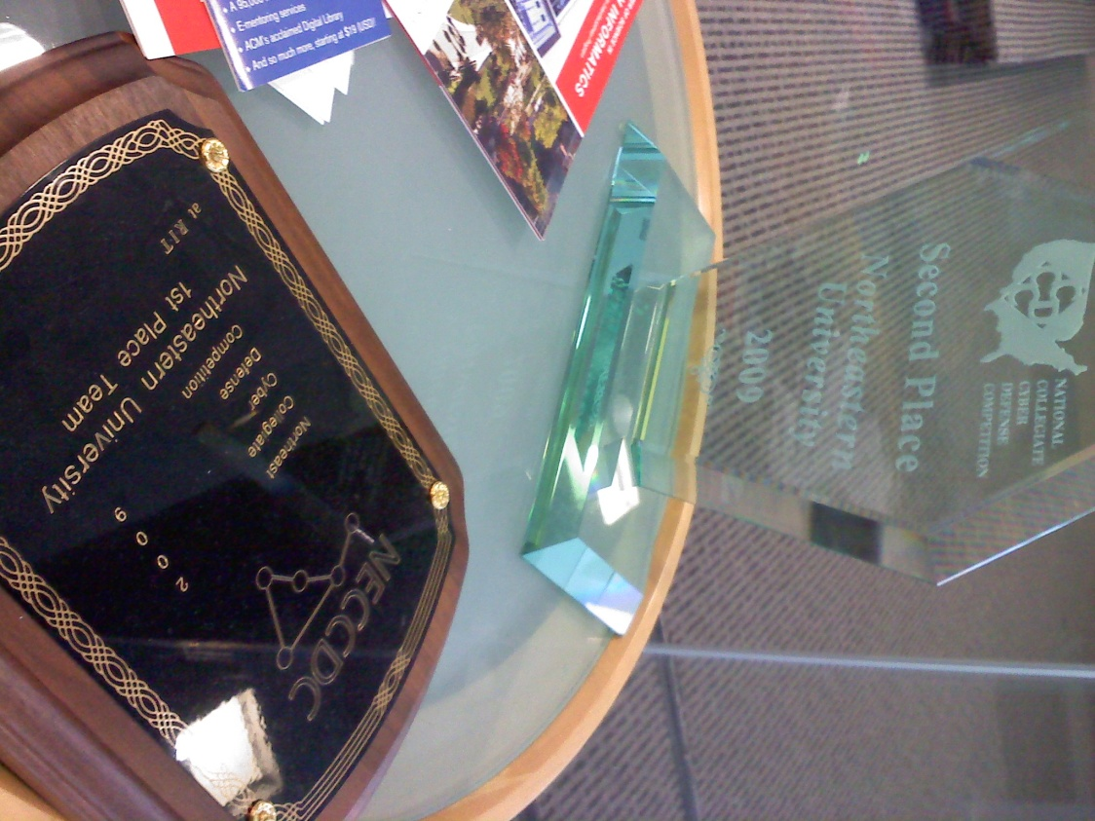
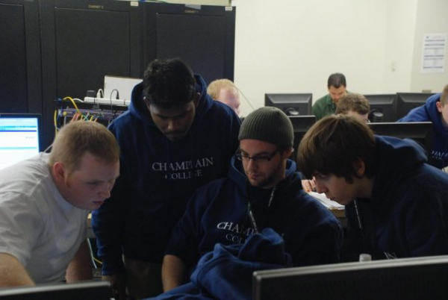
Readers digest version
NECCDC
Layout
Prep
Actual game day
Notes:
What competition is
Layout and rules
How we prepared, we participated last year
And how much of that prep went out of the window

Slide 3









NECCDC Background
Notes:
What exactly is NECCDC
cyber collegiate defense competition for northeast region
they have these all around the country
The goals are relatively simple
it’s a setting that allows industry and academia
to foster a competitive environment for undergrad and graduate teams
to compete with their knowledge of information assurance
in a defensive based competition
maintain and defend enterprise network
time limits severally limit best practice approach, mc-guiver-esk solutions often employed

Slide 4
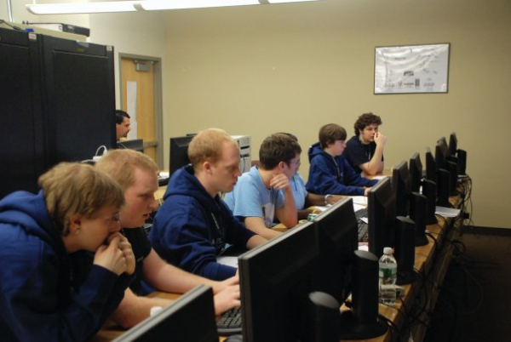
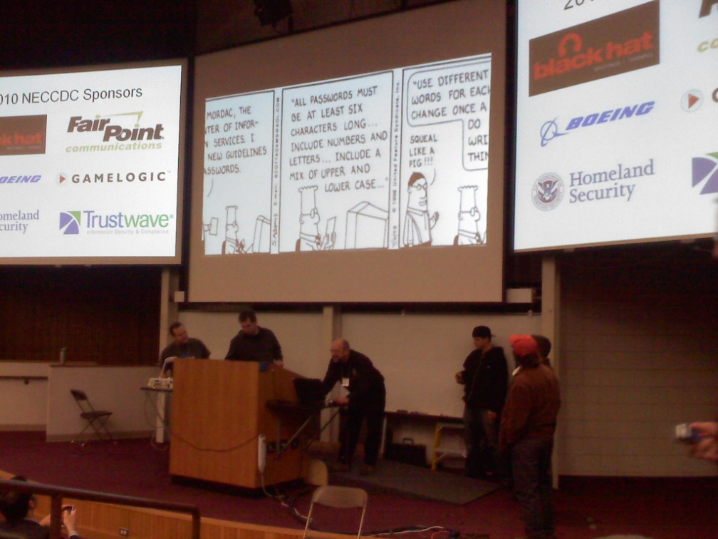
Rules
Defensive only
Rewarded for
Data Preservation
Services
Injects
Penalized for
Successful breaches
Notes:
Defensive only event
not allowed to attack red team or other blue teams
Rewarded for
data preservation: Active Directory, Email, website, credit card info etc
services: http, https, DNS, email
Injects: time based objects to complete that adds functionality to network
occasionally trades points for additional avenues for attack
Penalized for Successful breaches
red team will use numerous means of penetrating our networks
some systems might have been compromised from get-go
can get points back by documenting successful break ins and
supplying information on how to mitigate damage

Slide 5











Layout
Red Team
Cisco Router 1841
Cisco Catalyst Switch
Notes:
Each team is given an identical network
1 router
1 switch
4 servers
4 workstations
and 1 red team that attacks every blue team
Get points for retaining data, keeping up services, and by adding things to network in the form of injects
Lose points for red team getting in, losing data

Slide 6
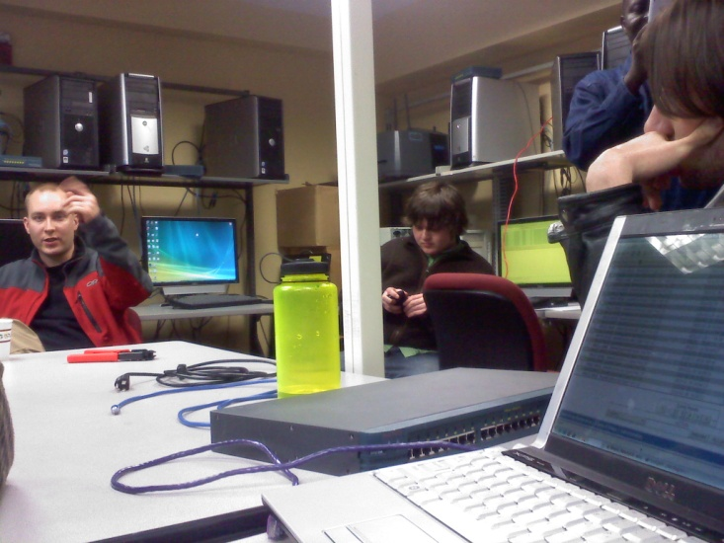

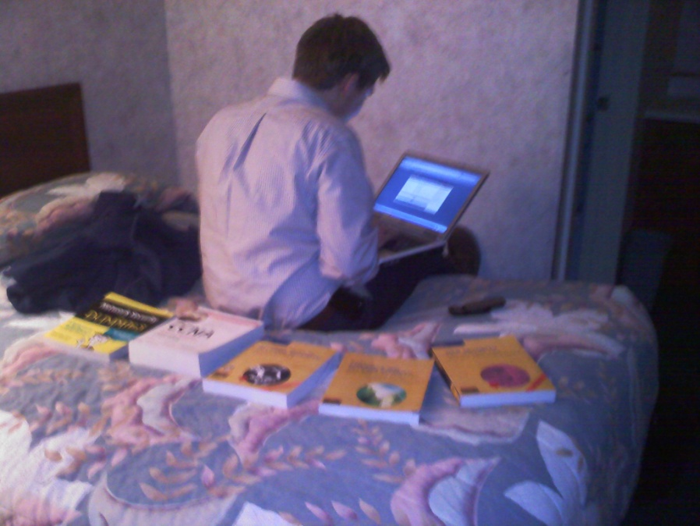
Prep
Perimeter Approach
Lockdown guides
Detection
Notes:
Perimeter Approach
ACLs only allowed limited traffic
severely limited red teams avenues of attack
Lockdown guides
mindset that we will be compromised
applied NIST and NSA lockdown guides
how to lock down system to these standards
Detection
how can we detect anomalies on our systems and network
chosen network IDS to see what was attempting to access internet
this allowed us to see what avenues of attack red team was doing.
and focus on specific machines that were targets/compromised

Slide 7
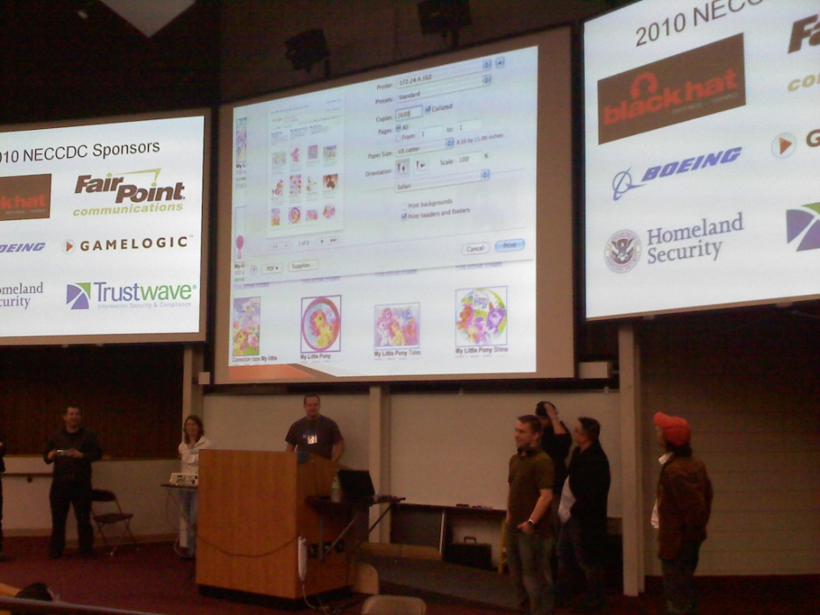
Day 1 11am -7pm
Passwords
Screen saver exploit
OS Switch
Compromised router
Keylogger
SNMP
Wireless Printer
Windows 2008 down
DNS poisoning
Security websites
Notes:
Passwords
0ftcrack
Konboot
Nt recovery
Screen saver exploit
Debian Solaris Switched
Compromised router
Actual Keylogger
SNMP
Wireless Printer

Slide 8
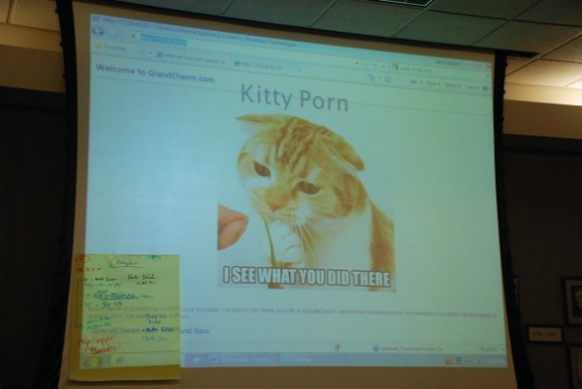
Day 1 continued
Windows 2000 domain
IPsec firewall on 2000*
Unix Based
IP tables
tripwire
Windows 2000 hit
RPC hit on port 135
Similar to blaster, NT authority shutdown
Refined IPsec
Internal vulnerability scans
Notes:
Windows 2000 domain
IPsec firewall on 2000*
Unix Based
IP tables
Md5 hashes
Windows 2000 hit
RPC hit on port 135
Similar to blaster, NT authority shutdown
Refined ipsec to limit RPC traffic
Internal network scans
Nmap
Nessus

Slide 9
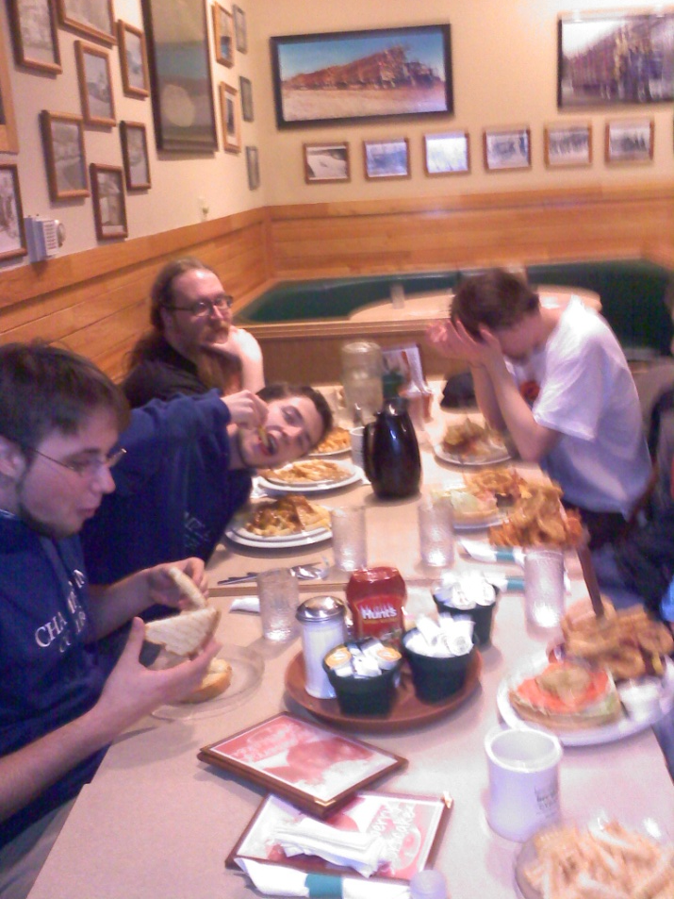
Day 2 8am-7pm
Windows 2008 issues
Compromised?
Image issues
AD replication failed
Hypervisor exploit
RE3 to Cent OS 3.0
Win XP reinstall
Wireless fiasco
Slackware
HTTPS
Notes:
Limited GUI
Imageburn banner
98% of image on disk
Fresh disc
Windows 2008 issues cont
AD replication failed
RPC service fail
Hypervisor exploit

Slide 10



Day 2 Layout
Cisco Router 1841
Cisco Catalyst Switch
BROKE
BROKE
BROKE
Notes:
Each team is given an identical network
1 router
1 switch
4 servers
4 workstations
and 1 red team that attacks every blue team
Get points for retaining data, keeping up services, and by adding things to network in the form of injects
Lose points for red team getting in, losing data

Slide 11
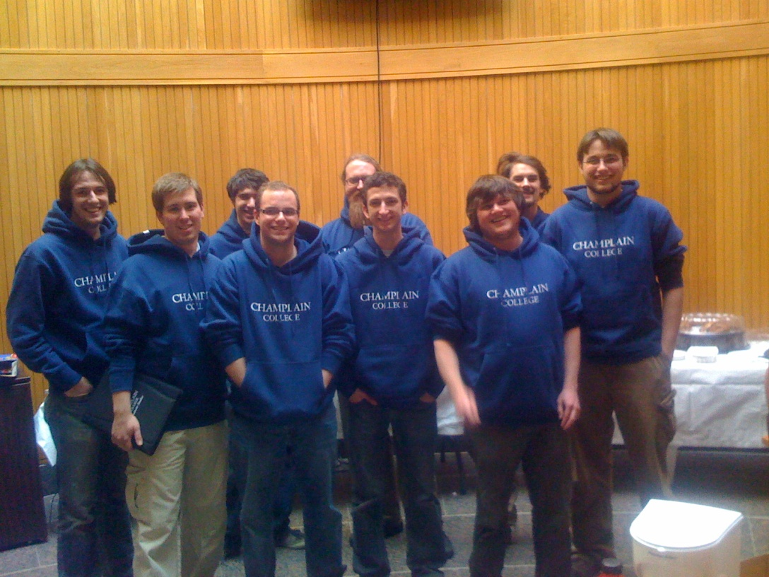
Prep for next year & ranking
Windows 2008 server core
Host Based IDS
Consolidated logging
Placement
Notes:
Windows 2008 server core
we could have install a minimalistic no GUI version
Host Based IDS
OSSEC, more visibility and does not really on dedicated machine
or machine with 2 NICs
Consolidated logging
easier for captain to have macro level view of whole event
and would free up captain to assist with more injects
Placement
only announced top 3 teams
likely we took 4th or 5th
but certainly beat Harvard

